Slide 1

Welcome to Career Day at the Berry Center
Brought to you by:
S.W.A.M.

Slide 2
Career Day
This is the 4th annual Career Day at the Berry Center.
Career day has grown since it first began and has provided many students with job opportunities and motivation toward a better life.
Since March 2004, it has been our mission to help the leaders of tomorrow meet the leaders of today.
S.W.A.M. is a nonprofit organization and runs on volunteers and donations.

Slide 3
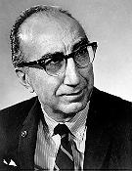
Dr. Michael DeBakey
An internationally recognized and respected physician and surgeon, noted for his pioneering work in the field of cardiovascular surgery, as well as for his innovative research into this and other fields of medicine.
He is credited with inventing and perfecting scores of medical devices, techniques and procedures which have led to healthy hearts and productive lives for millions throughout the world.
Speaking times:10:00 - 11:00am

Slide 4
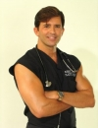
Dr. Robert Rey
Born in Brazil, and came to this country pursuing the American dream. One of his dreams was attending Harvard Medical School, and he achieved that dream. That is where he completed his plastic surgery fellowship. Now he has dreams of conquering the most competitive place for a plastic surgeon, Beverly Hills. Dr. Rey has been in practice for 5 years. In that time he has worked on numerous patients, including celebrities.
Speaking Times:
11:00 – Noon

Slide 5

LUNCH WILL BE PROVIDED BY:
A full list of entrees are available in the lobby
Lunch times:
      Noon-1:25pm

Slide 6
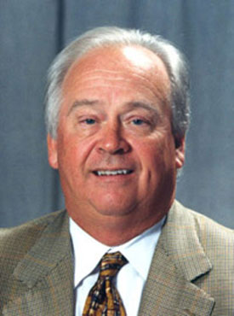
Dr. James Andrews
Orthopedic surgeon, is one of the founding members of the Alabama Sports Medicine and Orthopedic Center, American Sports Medicine Institute in Birmingham, Al.
as well as The Andrews Institute and Andrews Orthopedic & Sports Medicine Center in Gulf Breeze, Florida.
Doctor Andrews is internationally known and recognized throughout the world for his scientific and clinic research contributions in knee surgery.
Speaking times: 1:30-2:00pm

Slide 7
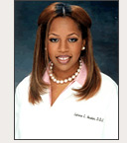
Dr. Catrise Austin
Has become one of the most sought-after cosmetic dentists in the nation. After completing extensive training at the University of Maryland's Baltimore College of Dental Surgery, Dr. Austin began to build a reputation for producing some of the most gorgeous smiles in the entertainment industry. Since she started her practice in New York over 10 years ago, she has become the cosmetic dentist of choice for such notables as Toni Braxton.
Speaking times:
2:30-3:30pm

Slide 8
Contact Information
Geoff Royce:
  Email-Groyce@swam.com
Kristen Faris:
  Kfaris@swam.com
David Spiegel:
  Dspiegel@swam.com
Charles McKirahan:
  Cmckirahan@swam.com
Sean Flores:
  Sflores@swam.com
Berry Center
8877 Barker Cypress Rd.
Cypress, TX 77433
Conference Room #B212
10:00 AM – 2:00 PM
Phone Number:
  713-123-4321

